Slide 1

Fuel Economy Analysis
Finding the best options:

Slide 2
What we are looking for:
Data-driven analysis of Fuel Economy

Slide 3
What we are looking for:
Data-driven analysis of Fuel Economy
Per Manufacturer

Slide 4
What we are looking for:
Data-driven analysis of Fuel Economy
Per Manufacturer
Per Class of Vehicle

Slide 5
What we are looking for:
Data-driven analysis of Fuel Economy
Per Manufacturer
Per Class of Vehicle
What we excluded:
Transmission Type

Slide 6
What we are looking for:
Data-driven analysis of Fuel Economy
Per Manufacturer
Per Class of Vehicle
What we excluded:
Transmission Type
Drive Train

Slide 7
What we know:
No Significate difference in HWY MPG
Significate Difference in CTY MPG

Slide 8
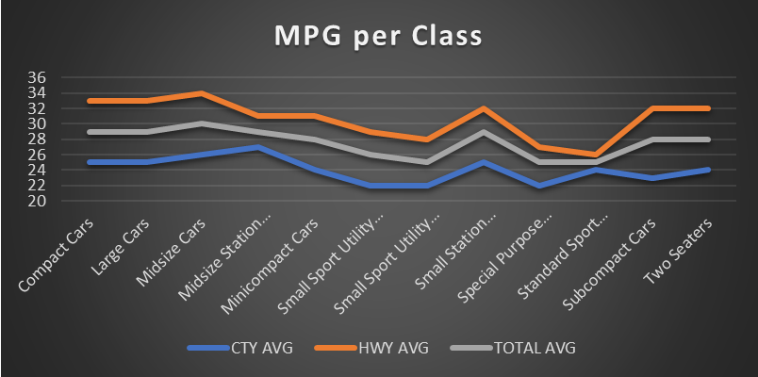
Gasoline Based Vehicles
Station Wagon or Hatchback style vehicles tend to get better CTY MPG
Sports Cars, Trucks and SUVs tend to get lower MPG

Slide 9
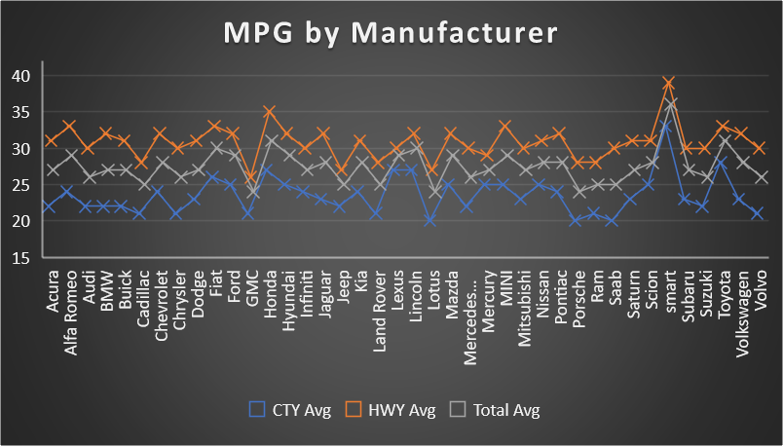
Gasoline Vehicles
Manufacturers focused on smaller vehicles tend to have better MPG overall
Foreign Manufacturers tend to have better MPG

Slide 10
Hybrids in the Mix
Better CTY MPG
Similar HWY MPG
Overall better Fuel Economy

Slide 11
Conclusions:
Primary usage of HWY has little to no impact on Fuel Economy
Consider manufacturers of small to mid sized cars for primary city usage
Move to Hybrids for city only usage

Slide 12
Where to go from here:
Look at driving styles
Consider electric vehicles

